Slide 1

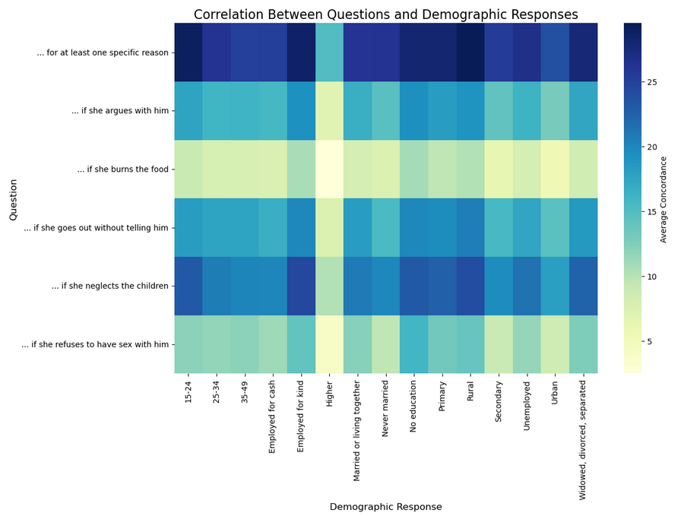
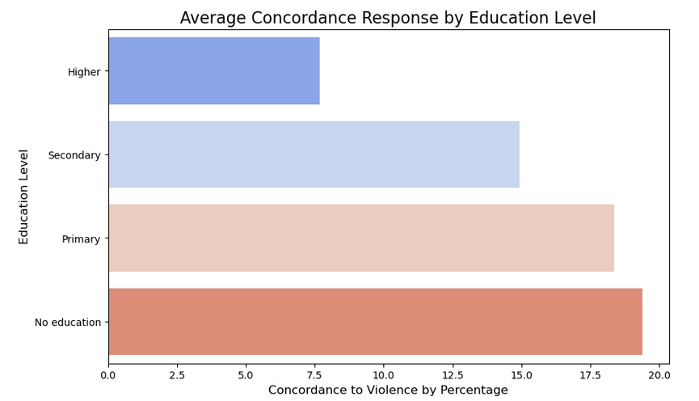
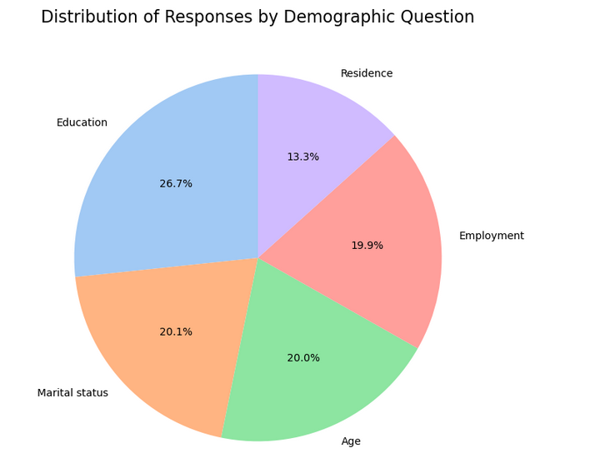
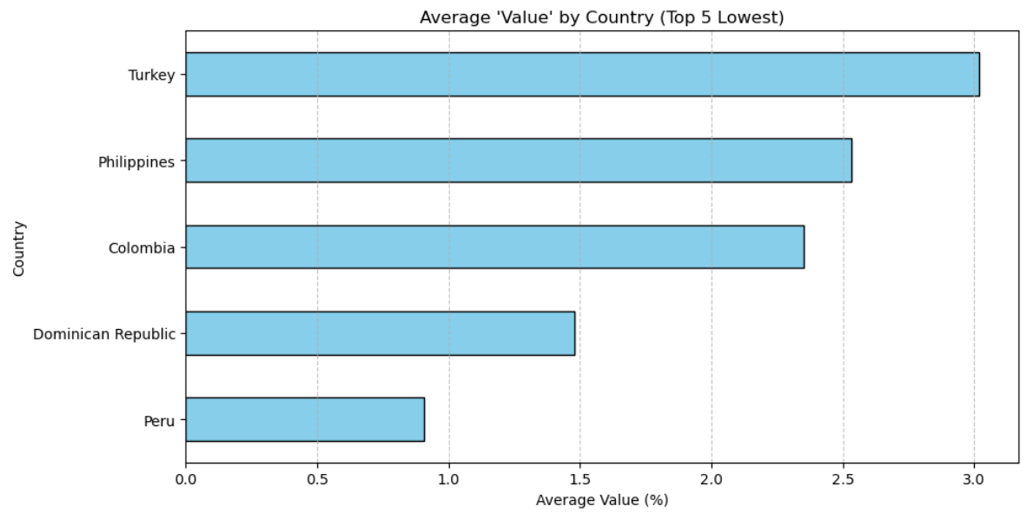
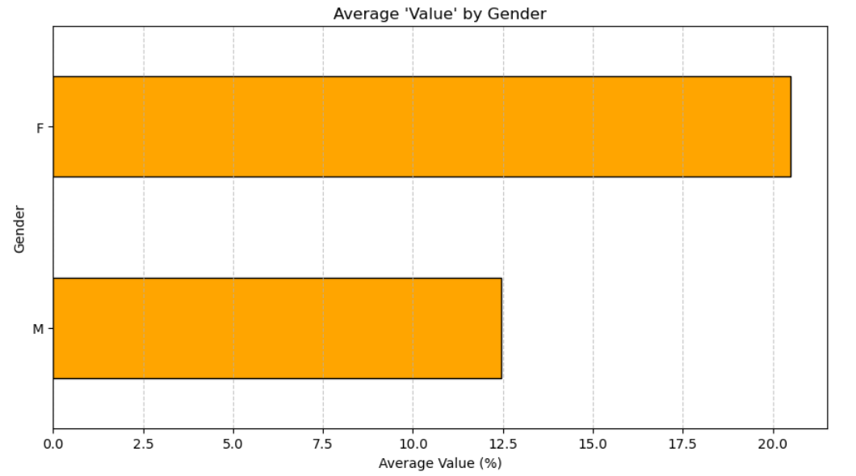
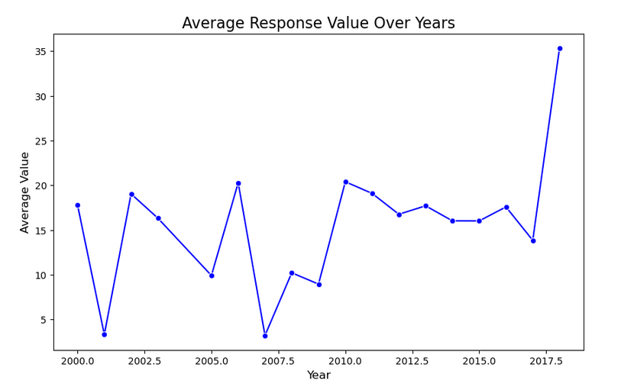
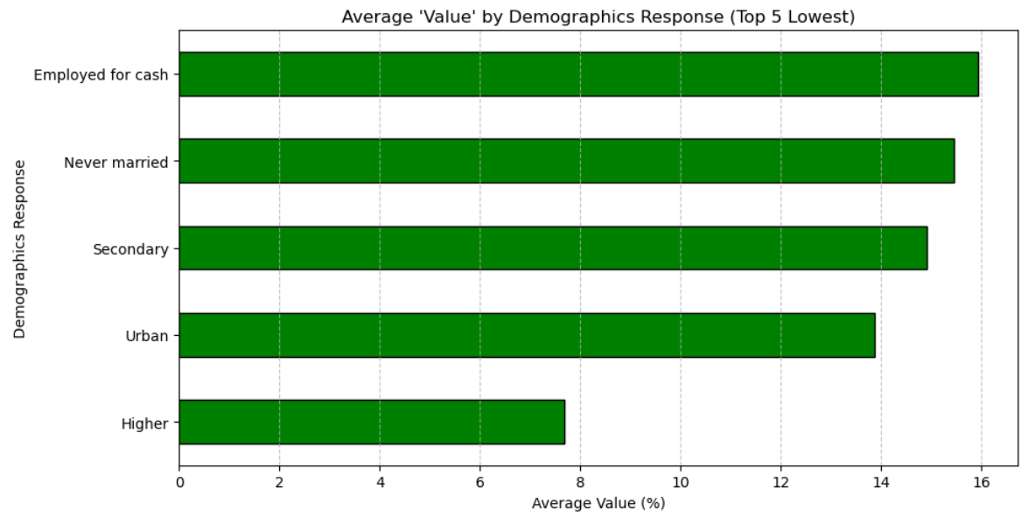
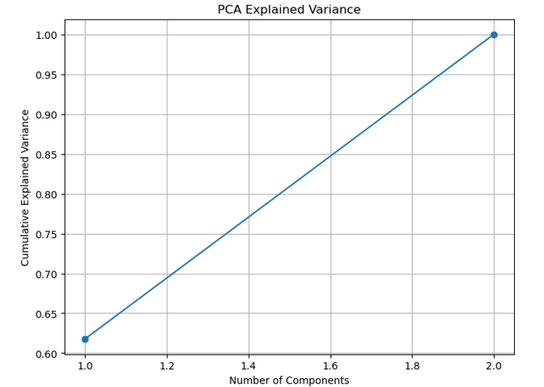
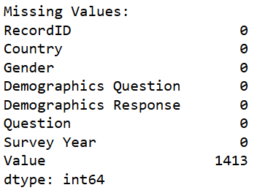
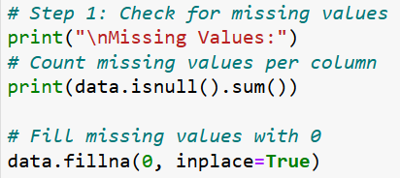

Understanding Violence Against Women and Girls: A Data-Driven Approach
Author: Charles Rocha | Lecturer: Dr Muhammad Iqbal | CCT College Dublin
1. Introduction
4. Exploratory Data Analysis
6. Key Findings
Violence against women and girls is a critical global issue. This project uses data analysis to identify patterns and insights, aiming to support awareness and policy-making.
EDA revealed trends such as regional variations in violence and correlations between economic factors and incident types, visualized using heatmaps and plots.
Lower education levels showed higher violence rates. Surprisingly, women showed more agreement in violence than men.
Multiples patterns can be seen for each of the questions made. Easily is noted that higher education shows less agreement to violence.
2. Dataset Overview
Something that is expected is higher education levels responses showing less accordance to violence.
The dataset from Kaggle contains over 3,000 records on violence against women, including attributes like region, type of violence, and incidents reported.
In the chart aside it is shown the 5 countries where there are less average agreement to violence.
The data was collected from different type of context, including revelant aspect as Education, Age, Marital Status, type of Employment and Residence, as it can be seen aside.
However, surpringly, women responses agreeing with violence was higher than men responses.
The questions was made from 2000 until 2017, showing changes accros the time, probably because socail trends.
In demographics responses it can be seen a pattern that shows a big city profile.
3. Data Cleaning and Preparation
5. Principal Component Analysis
7. Conclusions
Missing data was imputed, outliers removed, and categorical variables encoded. Scaling was applied to prepare the data for deeper analysis. In the column “Value”, null is 0. The code fixed that.
PCA reduced the dataset to two key components, retaining most of the variance. This simplified the analysis while highlighting influential factors.
Violence against women is devastating, but in the countries and contexts where the research was conducted, there was a significant number of people who do not see a problem with it. It is worth mentioning that the more educated people are, the lower the agreement rates, showing greater empathy and awareness.
References
Raphaëlle Rafin, Nabamallika Dehingia, Juncal Plazaola-Castaño and Raj, A. (2024). Rapid surveys on violence against women in crisis contexts: decision-making guidance based on the UN Women Rapid Gender Assessment surveys on violence against women during COVID-19. The Lancet Global Health, [online] 12(11), pp.e1899–e1904. doi:https://doi.org/10.1016/s2214-109x(24)00278-x. (Raphaëlle Rafin et al., 2024)
Shahriar, A.Z.M. and Alam, Q. (2024). Violence against women, innate preferences and financial inclusion. Pacific-Basin Finance Journal, 87, p.102482. doi:https://doi.org/10.1016/j.pacfin.2024.102482. (Shahriar and Alam, 2024)
Sukanya Paradkar, Singh, C., Anand Suryavanshi, Tiwari, A., Beniamino Cislaghi, Nayreen Daruwalla, Osrin, D. and Gram, L. (2024). ‘Mostly women’s issues’ – Gender differences in community responses to a large-scale NGO programme to prevent violence against women in urban India. Women s Studies International Forum, 107, pp.102997–102997. doi:https://doi.org/10.1016/j.wsif.2024.102997. (Sukanya Paradkar et al., 2024)
Our Dedication.Your Journey.

